Slide 1
Computer Architecture in the 21st Century
Chuck Thacker
Microsoft Research Silicon Valley
January, 2013

Slide 2
Outline
Some review
Why networking and architecture must merge.
How can we continue to improve both?
Some remaining challenges.

Slide 3
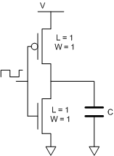
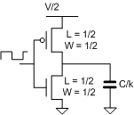
Some physics – Dennard scaling (1975)
P = CV² f
Relates power, capacitive load, operating voltage, and frequency in CMOS circuits.
If we scale the dimensions and V down by k:
P’ = (C’ V’²f’) = (C/k)(V/k)² f’ = CV²f/k³
Capacitance is C/k because although the area goes down by k², the dielectric is 1/k as thick.
k is the “feature size”: 90nm -> 45 nm is k = 2.
Our new circuit is 1/k² the area and1/k³ the power (at the same frequency) of the original version.
Our new chip should also be cheaper, since $ = Area.
This works well for feature sizes > 100nm or so.
It doesn’t work today, since we can’t continue to scale V, and we can’t get rid of the heat.
If f’ = kf, the power per unit area is unchanged. Making a bigger chip means making a hotter chip.
Semiconductor makers have used scaling in very different ways for memories and CPUs.

Slide 4
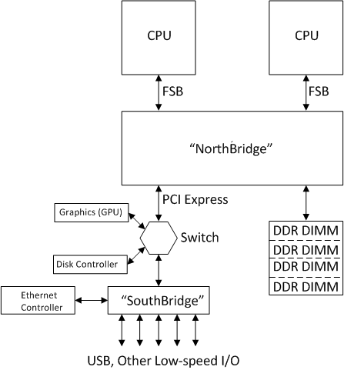
An early 21st century PC “mother board”

Slide 5
A 2012 “System on a Chip” (SOC)
The arrows show the off-chip connections

Slide 6
SOC basics
Usually a few traditional CPU cores,
With other specialized functions:
Network and disk controller
Memory controller
Low speed I/O controllers
Connected by an on-chip network.
Optimized for a specific application:
Mobile phone
Tablet
Desktop
Data center server
SOCs make sense only in high-volume multi-generational applications, where they are mandatory for low cost.
Specialization is the key to making innovative, differentiated products that consume less energy.
A specialized block can be 100X the energy efficiency of the same function implemented in software running on a CPU.
But specialization conflicts with the need for high volume.

Slide 7
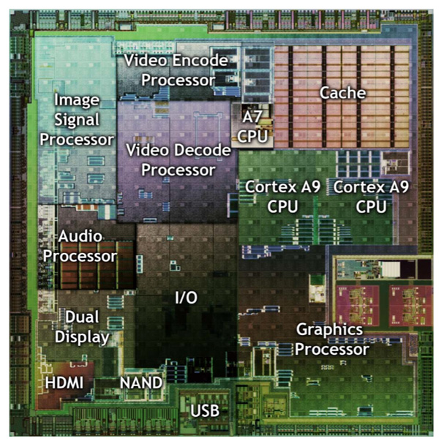
A Typical SOC
Nvidia Tegra 2: 75% of chip is specialized HW

Slide 8
SOC requirements
To use SOCs effectively, a manufacturer must have:
A reliable source of IP (CPU/cache, on-chip networks, device and memory controllers. This can be internal or external.
Design tools to aggregate and interconnect the IP. CAD vendors supply these tools today.
Product designers to specify the functions and employ the tools.
Designs and their functionality must delight customers, or the needed volumes will not be achieved.
Do not need:
A silicon fabrication facility
A final product assembly plant.

Slide 9
Another approach to specialization
Field-programmable gate arrays (FPGAs)
Clean-slate design at the gate (logic) level.
High volumes, since differentiated designs can be produced with the same chips.
Simple silicon, so can be introduced rapidly in a new process
A lot of the transistors in an FPGA consume no power whatsoever.
Energy efficiency is not as great as with full-custom or ASIC designs
But if frequently good enough, particularly for algorithms that don’t work well in software running on a general purpose CPU. (e.g. compression, crypto)
So modern FPGAs contain “hard” functions that can be interconnected (and powered down when not used)
CPU cores (Xilinx Zynq family has 2 ARM cores with caches)
DSPs (hundreds)
Embedded RAM (megabits)
High speed I/O (for networking)
External DRAM controllers
Controllers for common I/O standards (e.g. Ethernet)
Lots of logic
The MAXC computer would fit in a single modern FPGA
So would a few dozen Alto computers (with their memory and disks)
Problems:
Can’t use all the logic; wires are usually the thing that limits a design
You pay for logic that you don’t use.

Slide 10
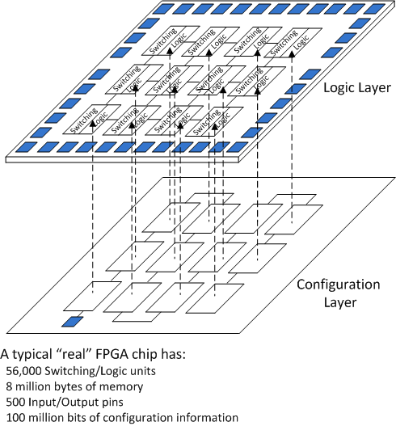
A Field-programmable Gate Array (FPGA)

Slide 11
Another use for FPGAs: Networks
The Internet resists innovation
Protocols are standardized
To communicate, must use common protocols.
Data centers are different:
Single owner
Fewer nodes (tens of thousands rather than billions)
Links are short and have similar performance
Topology is known
Network within a data center requires much higher bandwidth than the connections into and out of it.
Can we take advantage of these differences to build a lower-cost more energy-efficient network for our data centers?
Yes

Slide 12
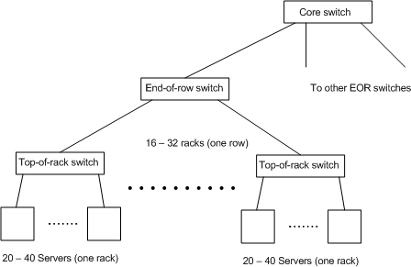
Current data center practice
24 – 48 port switches are common
Problem: Need more bandwidth near the root of the tree.

Slide 13
The AN3 network
Assumes shipping containers are used, but this is optional.
64 containers (“forty footers”)
Each with two rows of 16 44 “U” racks
Each half-rack has 22 1U servers with 4-port 5Gb/s switch/NIC (network interface controller) that form a small sub-network. Two of the NICs have a 10 Gb/s “uplink” port.
Each L0 sub-network connects to two Level 1 switches, each with 128 10 Gb/sec ports.
64 L1 ports are for the connections to L0 sub-nets, 64 are used for connections to 63 other containers and the network operations center (NOC).
No central switching needed
1408 servers/container, 90,112servers/center
Somewhat surprisingly, both the NICs and L1 switches can be implemented cost-effectively with FPGAs
These have “hard” 10 Gb/s transceivers
They have enough buffering – “block RAMs”
They have enough logic
We do not need “top-of-rack” switches.
Less engineering
Lower cost
Higher bandwidth for traffic within the subnet

Slide 14
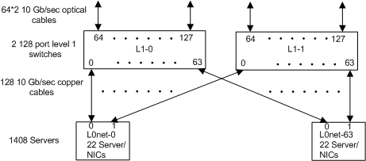
The switches in one container
A 64-container data center has a bisection bandwidth of 32*64*10*2 Gb/s = 41 Tb/s
The entire Internet has been estimated to have a bisection bandwidth of 100 Tb/s

Slide 15
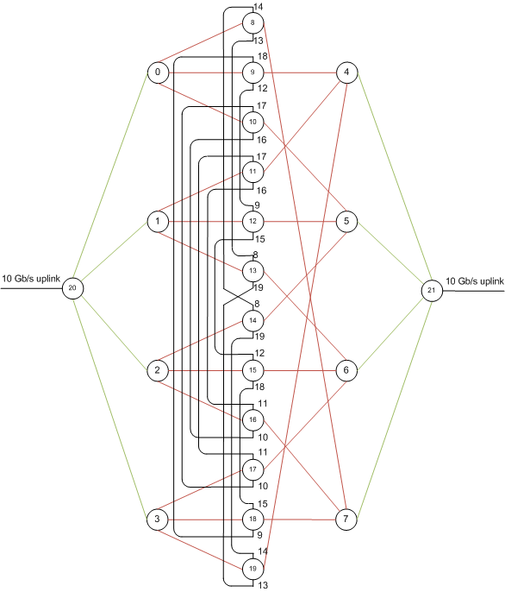
The L0 Sub-network
44 cables (2816 total)

Slide 16
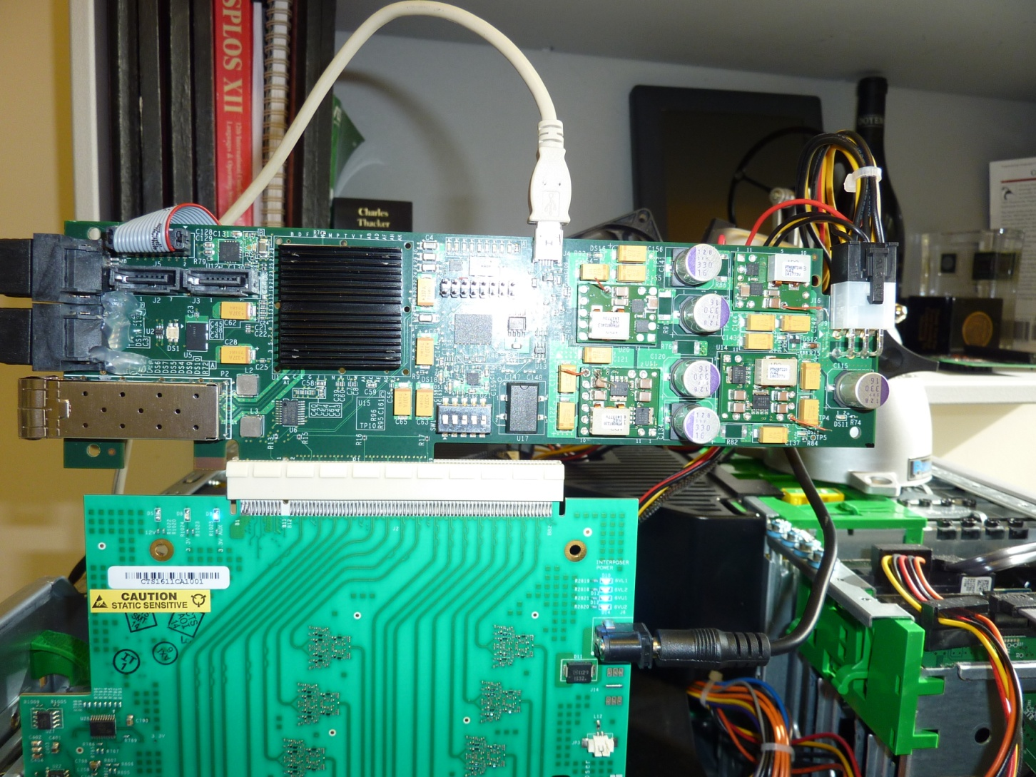
The AN3 NIC

Slide 17
Circuit- vs. packet- switched networks
Both types are common
LANs and the Internet use packets
Phone networks use circuits
Primary difference is the way congestion is handled
Packet switches drop packets on congested paths.
Circuit switching uses admission control – don’t accept a call if it would oversubscribe a switch or link.
Data flows are handled differently
Packet switches use variable-length packets for data
Circuit switches send data in fixed-length cells, carried in larger fixed sized frames. Each slot carries a cell for a particular flow, established at call setup time.
Circuit switches are simpler than packet switches
Little buffering is needed, since cells are forwarded quickly. Packet switches use queueing to handle momentary overload, and have huge buffers.
Routing decisions are much simpler, since routing and buffer allocation is done at setup time. This makes scaling to higher link rates (40 – 100 Gb/s) easier.
In a large network, packets are used because “call setup” overhead is too high.
In a phone network, this is OK, since voice calls are usually longer than call setup (dialing).
Also OK if you can statistically multiplex many connections onto a single flow. Large ISPs do this.

Slide 18
Key ideas in AN3
Circuit switching rather than packet switching
Fast call setup
Speculative transmission
Eliminate the usual top-of-rack switches
A full data center has only 128 L1 switches, but 90,000 NICs
Can reduce the NIC’s cost even further with ASICs

Slide 19
Another area for improvement: Memory systems
Approaches to overcome the memory wall:
Use new semiconductor technologies
Flash, Phase Change, MRAM
Get the memory closer to the CPU
Die stacking
Change the way the CPU accesses memory
Transactional memory

Slide 20
Flash memory
Properties:
Two kinds: NOR and NAND
Both store data by trapping charge on a “floating gate”
Density is ~4X DRAM
Nonvolatile, no refresh
Block oriented
Must erase a block (to all 1’s) before writing it
Writing turns 1’s into 0’s, but not the other way.
Writes must be to sequential addresses
Reads are fast, writes are slow.
Wears out with use
10⁶ erase/write cycles
This may have been solved recently

Slide 21
Flash Applications (2)
NOR: BIOS storage, FPGA bitstream storage
NAND: Disk replacement (SSD = “solid state disk”)
Cost per bit is 10X a magnetic disk
No rotational delay
No seek time
Great for data that is mostly read randomly, and which can be written sequentially (a log).
This is done in a “Flash translation layer”
Some vendors use non-disk interfaces to improve performance
Another option: Change the system storage hierarchy
Now: CPU -> Cache -> DRAM -> Disk
Future: CPU -> Cache -> DRAM -> Flash -> Disk

Slide 22
Die stacking
A packaging trick that allows us to change the architectural interface to the DRAM.
Can transfer more data at once because the wires are smaller, and have less capacitance
Many problems:
Must thin the DRAM die
Must have vias through the die
Must use known-good die
Can’t repair a stack

Slide 23
Transactional Memory
> 500 papers in the last decade
Problem with parallel computing: Shared, mutable state.
Usually handled with mutual exclusion, but programming with locks is very hard, since locking abstractions don’t compose.
Simple idea from data bases. Transactions are regions of a program with ACID properties:
Atomic: “All or nothing”
Consistent: Data is never visible in an inconsistent state
Debit/credit example
Isolated: Execution is equivalent to some serial interleaving of the transactions. If one transaction would affect another, one of them aborts.
Durable: Survives system crashes, power failures
Hardware transactional memory usually doesn’t do this.
TM is beginning to appear in CPU architectures
But we need to gain experience in using it in real programs.

Slide 24
Final thoughts
We still have a lot of unsolved problems in computing.
Until/unless a radical new technology appears, improvements in architecture and software improvements are our major lever.

